Slide 1
Causal Probabilistic World Model for Clinical Treatment Reasoning
Bayesian Network Causal Discovery on the ACTG175 AIDS Clinical Trial Dataset
Group Number: C-11
Sai Kushal B – CB.SC.U4AIE24252
Subash B – CB.SC.U4AIE24254
Naveen K – CB.SC.U4AIE24235
Charan Kumar Arepally – CB.SC.U4AIE24207

Slide 2
Outline of the Presentation
Introduction
Literature Review
Research Gaps & Motivation
Objectives
Overall Methodology
Probabilistic Reasoning: Inference & Learning
Causal Intervention & Treatment Decision
Modern AI Integration
Progress & Results
Weekly Timeline
References

Slide 3
Introduction
Clinical reasoning challenge
Predicting an outcome is different from estimating what would happen under a different treatment.
Project idea
Learn an interpretable causal Bayesian Network from ACTG175 trial data.
Model relationships among baseline patient characteristics, treatment and disease progression.
Use Bayesian inference to estimate posterior outcome probabilities.
Use intervention analysis, do(trt), to compare all four treatment options.
Expose the model through a Flask API and React dashboard.
Goal: estimate treatment-specific progression risk and rank available treatments.

Slide 4
Literature Review
Paper | Year | Method / Key Finding | Limitation / Gap
Hammer et al. — ACTG175 trial | 1996 | Double-blind clinical trial comparing nucleoside monotherapy and combination therapy; provides the treatment/outcome foundation for ACTG175. | Clinical treatment comparison does not provide a Bayesian Network for individualized what-if treatment reasoning.
Katzenstein et al. — ACTG175 virologic & immunologic study | 1996 | Analyzed virologic/immunologic markers, including CD4, and their relationship with clinical outcomes after nucleoside therapy. | Focuses on marker–outcome relationships; does not build a causal BN for treatment intervention and ranking.
Kyrimi et al. — Counterfactual reasoning with CBNs | 2025 | Uses causal Bayesian networks for counterfactual reasoning about alternative treatment decisions in healthcare governance. | Not focused on ACTG175 or automated four-treatment ranking with an explicit utility rule.
Zahoor et al. — Probabilistic Causal Fusion | 2026 | Integrates causal Bayesian networks with probability trees to support prediction, intervention and counterfactual reasoning across clinical datasets. | Broader fusion framework; not specifically focused on ACTG175 treatment comparison using our compact BN + do(trt) pipeline.
Literature foundation: ACTG175 clinical trial + causal Bayesian networks + probabilistic inference.
Key papers: Hammer et al. (1996), Katzenstein et al. (1996), Kyrimi et al. (2025), Zahoor et al. (2026).

Slide 5
Takeaways / Research Gaps from Literature
1. Prediction ≠ Causation
A predictive model can estimate risk without answering a treatment what-if question.
2. Black-box limitation
High predictive power does not automatically provide an interpretable causal explanation.
3. Observational comparison
Observed treatment outcomes do not directly equal counterfactual treatment outcomes.
4. Need for decision support
Clinical reasoning benefits from calibrated probabilities and explicit treatment alternatives.
Motivation: build an interpretable probabilistic world model that supports causal treatment comparison.

Slide 6
Objectives
O1
Causal Structure Learning
Learn an interpretable DAG from ACTG175 data under temporal/domain constraints.
O2
Probabilistic Model
Learn Bayesian parameters/CPTs and perform exact probabilistic inference.
O3
Treatment Intervention
Estimate P(label | do(trt)) for all four treatment options and rank them.
O4
Evaluation & Delivery
Validate the model on held-out data and expose results through an interactive dashboard.
Evaluation metrics: Accuracy • ROC-AUC • Log Loss • Brier Score • ECE • Treatment-decision comparison

Slide 7
Methodology – Overall
ACTG175 Data
Preprocess
Structure Learning
DAG Selection
Parameter Learning
Bayesian Network
Inference / Intervention
Dashboard
Structure learning
Parameter learning
Exact inference
Causal decision layer
Hill Climbing
Tabu Search
GES
BDeu prior • ESS = 10
Variable Elimination
do(trt) + ranking
PGM used: Discrete Bayesian Network represented as a Directed Acyclic Graph (DAG).

Slide 8
Methodology – PR Inference
PGM
Discrete Bayesian Network
Inference type
Exact inference
Algorithm
Variable Elimination
Patient Evidence
Bayesian Network
Variable Elimination
Posterior Probability
Example query: P(label = 1 | observed patient evidence) Exact inference is appropriate because the final network is compact: 17 nodes, maximum in-degree 3.

Slide 9
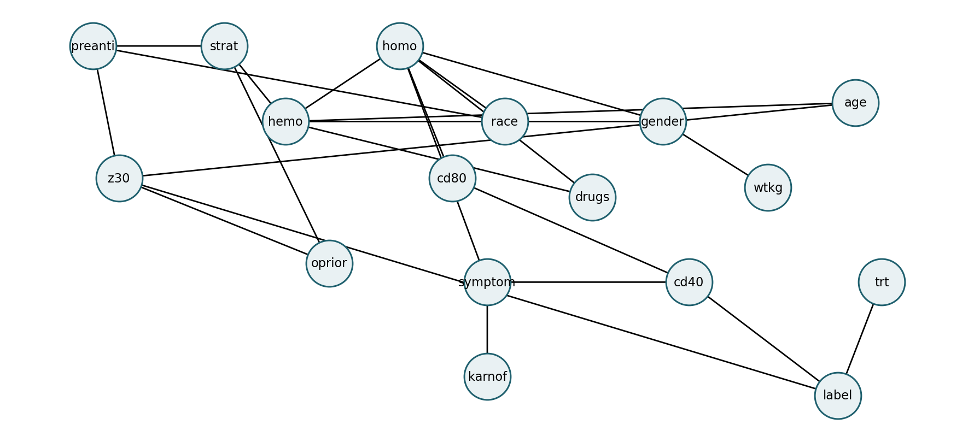
Methodology – PR Learning
1. Structure Learning
Hill Climbing Tabu Search GES Constraints: baseline → treatment → outcome; label → trt forbidden
2. DAG Selection
Hill Climbing: 22 edges Tabu: 22 edges Jaccard = 1.0 Bootstrap: 7 edges ≥75% support
3. Parameter Learning
BayesianEstimator BDeu prior ESS = 10 175 CPT entries; zero degenerate entries
Final 23rd edge: trt → label (added after baseline DAG selection for intervention analysis).
Final model: 17 nodes • 23 edges • maximum in-degree 3

Slide 10
Methodology – Decision, Intervention & What-If Scenarios
Association vs. intervention
Per-patient decision process
P(label | trt)
vs.
P(label | do(trt))
do(0)
do(1)
do(2)
do(3)
Predicted P(label = 1)
Rank treatments → recommend
Utility: label 0 = 1.0 (no progression); label 1 = 0.0 (progression). Higher expected utility = preferred treatment.
Decision rule: rank treatments by expected utility, equivalent here to choosing the lowest predicted P(label = 1).

Slide 11
Methodology – Combining with Modern AI
Data-driven ML Structure Search
Probabilistic AI Bayesian Network
Causal AI do(trt) Intervention
AI Application Flask + React
The project does not use deep learning; instead it combines modern ML-style structure discovery with probabilistic and causal reasoning.
Automated discovery: Hill Climbing, Tabu Search and GES.
Uncertainty modeling: BayesianEstimator + CPTs.
Causal what-if reasoning: do(trt) treatment interventions.
Delivery: validated model reused by a local Flask API and React dashboard.

Slide 12
Progress in terms of Project Objectives
Objective | Status | Evidence
Causal structure learning | COMPLETED | HC + Tabu + GES + bootstrap
Bayesian model | COMPLETED | 17 nodes • 23 edges • 175 CPT entries
Treatment intervention | COMPLETED | do(trt) across 4 treatments
Evaluation & dashboard | COMPLETED | 428-test validation + Flask/React
Accuracy
76.64%
ROC AUC
0.6372
ECE
0.0445
Decision comparison
75%
Interpretation: well-calibrated probabilities with modest discrimination; treatment comparison is model-based, not proof of individual clinical superiority.

Slide 13
Weekly Timeline for Project Completion
W1 — Problem definition, literature review & ACTG175 dataset analysis
Understand the clinical problem, treatment arms, variables and outcome.
W2 — Preprocessing & discretization
Schema validation, leakage control, sparse discretization and 1,711/428 split.
W3 — Causal structure learning
Temporal constraints; Hill Climbing, Tabu Search, GES and bootstrap stability.
W4 — DAG selection & parameter learning
Select baseline DAG; add trt → label for intervention; learn BDeu CPTs with ESS=10.
W5 — Inference, intervention & validation
Variable Elimination, do(trt), treatment ranking, predictive metrics and decision validation.
W6 — API, dashboard, testing & presentation
Flask API, React dashboard, final testing, documentation and PPT preparation.
Six-week timeline aligned to the project's implementation stages; exact calendar dates can be added if required.

Slide 14
References
Kyrimi, E., Mossadegh, S., Wohlgemut, J. M., Stoner, R. S., Tai, N. R. M., & Marsh, W. (2025). Counterfactual reasoning using causal Bayesian networks as a healthcare governance tool. International Journal of Medical Informatics, 193, 105681. DOI: 10.1016/j.ijmedinf.2024.105681.
Zahoor, S., Liò, P., Dias, G., & Hasanuzzaman, M. (2026). Integrating probabilistic trees and causal networks for clinical and epidemiological data. Artificial Intelligence in Medicine, 173, 103350. DOI: 10.1016/j.artmed.2026.103350.
Hammer, S. M., et al. (1996). A Trial Comparing Nucleoside Monotherapy with Combination Therapy in HIV-Infected Adults with CD4 Cell Counts from 200 to 500 per Cubic Millimeter. New England Journal of Medicine, 335, 1081–1090.
Katzenstein, D. A., et al. (1996). The Relation of Virologic and Immunologic Markers to Clinical Outcomes after Nucleoside Therapy in HIV-Infected Adults with 200 to 500 CD4 Cells per Cubic Millimeter. New England Journal of Medicine, 335, 1091–1098.
pgmpy Documentation. Bayesian Parameter Estimation and Variable Elimination for Bayesian Networks. pgmpy.
Project dataset: ACTG175 AIDS Clinical Trial Group Study 175

